Slide 1
NL2SQL: NLI Matching Model
Qingning Yao (Chris), Tao Yu, Dragomir Radev

Slide 2
Introduction
Summarizing SQL patterns from training data, identify which pattern matches the input question and construct SQL with question and pattern.

Slide 3
What is a Pattern?
A SQL stripped down to skeleton. For example:
Question: "Find the name of customers who are living in Colorado."
SELECT t1.customer_name FROM customers AS t1 JOIN customer_addresses AS t2 ON t1.customer_id = t2.customer_id JOIN addresses AS t3 ON t2.address_id = t3.address_id WHERE t3.state_province_county = "Colorado"
SELECT {COLUMN}
WHERE {COLUMN} = {VALUE}
select where equals
Pattern (Simplified and Naturalized)
SQL
Pattern
Notes:
FROM Clause
= -> equals

Slide 4
How many patterns are there?
Out of the 5000+ preprocessed SQLs that we are having right now, there are around 70 to 400 patterns depending on the level of simplification, and these should cover the vast majority of all SQLs in real life.
Notes:
Sort of mimics the way humans write SQL

Slide 5
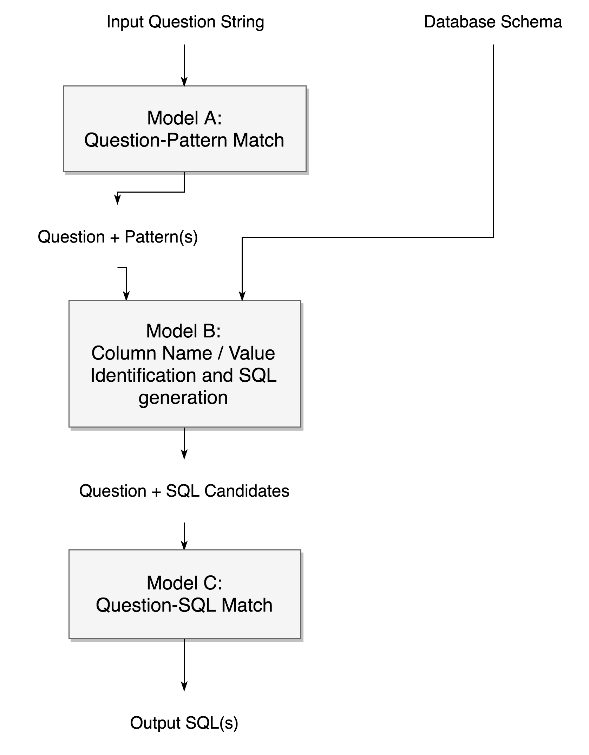
Model Structure

Slide 6
Model A: Question-Pattern Match
Given a question, predict which pattern would be the best fit for this question.
Using existing Natural Language Inference (NLI) models
Like paraphrase identification
Instead of "contradiction" / "entailment" etc., use "match" and "not match"

Slide 7
Training Model A
We used an NLI model by Zhiguo Wang, Wael Hamza and Radu Florian: Bilateral Multi-Perspective Matching for Natural Language Sentences (BiMPM).
Generate training data by
random mismatch of training question-pattern pairs
slightly tweaking a correct pair (to capture details)
Changed the evaluation metric
from "correctly identifying match/mismatch"
to "correctly identify the pattern out of all patterns"
Validation Accuracy:
96.6%

Slide 8
Model B: SQL Generation
Given:
Question
Predicted pattern of the corresponding query of that question
Database schema
Generate the most likely SQLs that would retrieve the answer to this question.
We can potentially reuse any other models in this project for Model B.
Notes:
Seq2SQL with more information

Slide 9
Model C: Question-SQL Matching
Given a question and a list of SQL candidates, identify which one among them would be the one that could correctly answer the question.
Potentially another NLI model
Could be trained just like model A
Notes:
Sound familiar again?

Slide 10
Pros and Cons
Pros:
Intuitive, analogous to the way humans learn and write SQL
Simple and straightforward
Cons:
Cannot guarantee 100% SQL pattern coverage

Slide 11
Potential Byproduct: Data Augmentation
Strip SQLs to skeleton, leaving behind replacements tokens
Like {COLUMN NAME} and {VALUE}
Use the non-keyword stripped from SQL to strip questions
Non-keywords: either column names or values
With other statistical approaches like word frequency
(Possibly) Hand pick some reusable high-quality Question-Pattern-SQL-Pattern pairs
Deduct column types statistically
E.g. can column order_type be GROUP BY’ed over?
Generate new Question-SQL pairs

